Slide 1
Waste Management in Nepal
University of British Columbia/ University of Tokyo
Christopher Kai Tannock

Slide 2
THE MOST IMPORTANT MESSAGE
Nepalese are under threat from poor waste management in the form of food and water insecurity. Water related diseases affect millions of Nepalese each year.
Healthy livelihood of people depends on the implimentation of effective waste management.
Despite abundant water resource available (second in the world), due to poor management of waste including sewages, water related disease like diaherrea, dysentry, typhoid, gastroenteritis, and cholera affecect million of people in Nepal. Every year 44,000 children die in Nepal from waterborne diseases. (From Water in Crisis – Nepal, https://thewaterproject.org/water-crisis/water-in-crisis-Nepal)

Slide 3
Let’s Prevent what can be Prevented
April, 25 th (2015):
The Earthquake striked Nepal,
7,000 people died, 8,100,000 people are affected
9.5 million people needed humanitarian aid
2.8 million people were displaced internally from lack of water and food.
These are not mere numbers.
It left scars on our family and friends. That came with a lot of grief and pain.
We must not forget the disaster but learn from that experience
Poor water quality from mismanaged waste can trigger severe human health disasters.
The “intensity” & “frequency” increases every year with climate change.

Slide 4
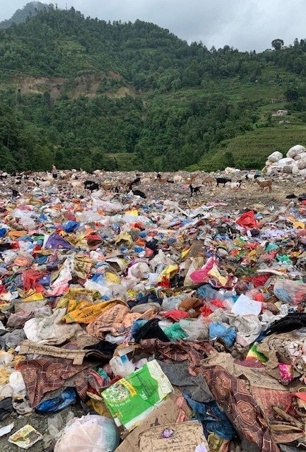
Introduction to Waste Problem
Nepal does not have proper waste management system. Including the capital Kathmandu.
In cities and rivers, solid wastes are thrown. Polluting the river and soil, resulting in hosting pathogens.
Collecting site is “open dumping” as opposed to proper engineered landfill; Nepalese dumping sites are mere empty fields, where they just dump garbage without any treatment.

Slide 5
Development Drivers for Waste Management
1. Inciting public health concern
2. Increasing environmental awareness
3. Promote institutional responsibility
4. Finding value from waste
Goal:
“phase out unctrolled disposal and to introduce either engineered landfills (intermediate) or full sanitary landfills” (p.202)
From Wilson, D. C. (2007). Development drivers for waste management.
Waste Management & Research, 25(3), 198-207.
https://doi.org/10.1177/0734242X07079149
Notes:
These are the drivers of installing proper waste management.
VIN can work to implement the system from these four approaches.

Slide 6
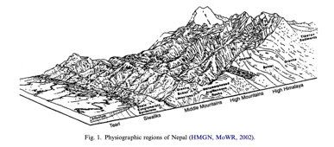
Driving Factor Breakdown
1. Inciting public health concern
Poor management of waste, including untreated sewage will impact the health of people immensly.
Increasing number of virus/pathogens
The combiantion of
poor water quality
increasing number of pathogens and virus
urbanizaiton
put people in substantial risk, economically and in health wise
Poor water quality
Urbanization
Case study:
The outbreak of plague in Surat, India in 1994
Plague that emerged from poor waste management killed 56 people.
The plague lasted only two weeks; howeverm, it caused widespread panic, impacted tourism industry and flights to Surat were cancelled. Economical damage was also substantial.

Slide 7
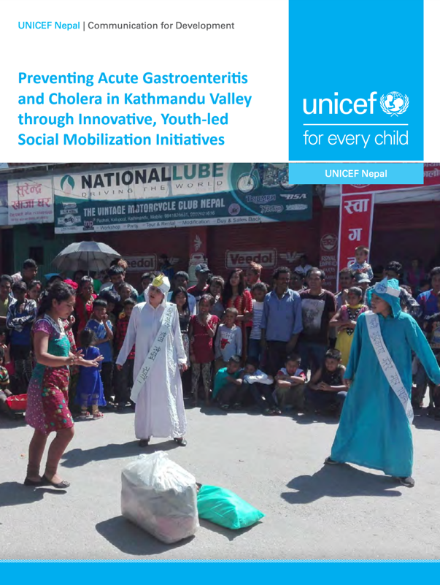
Driving Factor Breakdown
2. Increasing environmental awareness
Initiate social mobilization program that design to connect envirionmental pollution & human health impacts
Example in the past
Youth led social mobilization campaign to prevent cholera by UNICEF
(https://www.facebook.com/unicefnepal/videos/2178772229008549/ ,
https://www.unicef.org/nepal/media/1826/file/Preventing%20Acute%
20Gastroenteritis%20and%20Cholera%20in%20Kathmandu%20through%20
Youth-led%20Mobilization%20Initiatives.pdf)
Ideas
Educated college students and volunteers open classes on this subject in the local schools
Putting many posters in the city
Create fun Youtube videos depicting this situation that people watch

Slide 8
Driving Factor Breakdown
From Pokhrel, D., & Viraraghavan, T. (2005).
Municipal solid waste management in nepal: Practices and challenges.
Waste Management (Elmsford), 25(5), 555-562.
https://doi.org/10.1016/j.wasman.2005.01.020
3. Promote institutional responsibility undertake
~History of solid waste management in Nepal~
Traditionally:
Kuchikars (‘cleaners’) traditionally collected the wastes
1891:
Prime Minister Chandra Samsher established a “safai adda” (sanitary office) for increasing number of people & waste in Nepal
1950:
Town of Kathmandu, Patan, Bhaktapur were incorporated as municipalities and the responsibility of managing solid waste became municipality’s.
“To the public, this meant that they were no longer responsible for the managemnt of solid waste, this weakened the traditional practice of management through active community participation” (Pokhrel, 2005)
1980’s:
Before 1980’s solid waste management did not pose any serious issue
Solids wastes were managed by municipalities and “Kuchikars” collected
1981:
“The responsibility to manage the solid waste of Kathmandu valley was handed over to the Solid. Waste Management and Resource Mobilization Center (SWMRMC) funded by German Technical Corporation (GTZ)” (Pokhrel, 2005).

Slide 9
Driving Factor Breakdown
From Pokhrel, D., & Viraraghavan, T. (2005).
Municipal solid waste management in nepal: Practices and challenges.
Waste Management (Elmsford), 25(5), 555-562.
https://doi.org/10.1016/j.wasman.2005.01.020
3. Promote institutional responsibility undertake
~History of solid waste management in Nepal~
1986:
Sanitary landfill was build in Gokarna (where most of solid wastes are disposed).
Also recycling and fertilizer process plant were established at Teku.
1990:
Restoration of democracy in Nepal
One party Panchayat system collapsed, the political power were spread among various political parties
1993: GTZ witdrew the financial support and delegated the responsibility over to the municipal authority
Untill 1994, the landfill was operated haphazardly
1994:
Central governemnt undertook the responsibility to manage solid wastes
However, the management was poorly done and the garbage piled up in many areas of public spaces (Tundikhel)
Gokarna landfill was closed due to strong public opposition (it operated untill 1998)
After the landfill closure, Nepali government established landfill site by the bank of the Bishnumati river without considering the environmental impacts
2005:
Sisdol landfill site was constructed. It is planned to be used for another 35 years

Slide 10
Driving Factor Breakdown
3. Promote institutional responsibility undertake
Mission
Solid waste management in Nepal is munincipal problem as well as national scale issue. All of which is responsible for the central governemnt to take definitive action, thus we need to pressure the government to take full responsibility over the management, urgently, to have the plan for protecting its people.
Actions NGO can take
Appealing to government from NGO
By the virtue of democracy, if people want it desparately, government would have no choice but to take actions
Increase people’s awareness that we can change, we have power to promote changes.
Events
Fundraising
Campaign
Education
Empowering people for participating in changes

Slide 11
Driving Factor Breakdown
4. Finding value from waste
Unemployment is the second biggest issue next to sanitation for urban settlers in Nepal
We must find the way to solve both issues
“Wastes are resource”
Entrepreneurial ideas to make use of wastes & create jobs
To build more resilient society
This rules entrepreneurial thinking,
Take the example of Indonesian upcycling

Slide 12
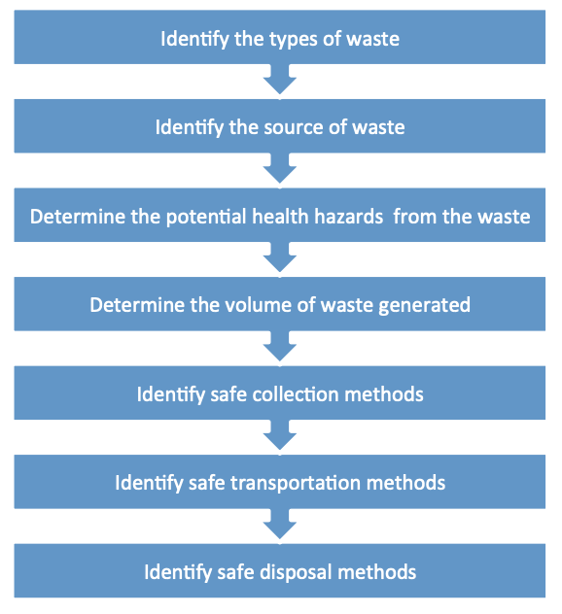
Guiding Principle for Waste Management

Slide 13
Life Cycle of Garbages in Nepal Kathmandu case
427 tons/day for entire country
291 tons/day in Kathmandu area
Volume of Wastes
Household: 0.17kg/capita/day
School: 4kg/school/day
Office: 1.4kg/office/day
(Asian Development Bank, 2015 data).
Notes:
“The amount of Municipal Solid Waste (MSW) differs from 1.3 tons/day to 123 tons/day within Nepal (“Municipal Waste Treatment Culture in Nepal”, 2016)
Solid Waste Management and Resource Mobilization Center (SWMRMC) estimated that the amount of waste generated by Kathmandu valley could be 350 tons/day by the year 2002.
(“Municipal solid waste management in Nepal: practices and challenges”)
* Needs to confirm the current amount, need to contact them
Kathmandu –
Household: 0.17kg/capita/day
Institutions: 4kg/school /day, 1.4kg/office/day (Asian Development Bank, 2015 data).
The total solid waste generation is 427 tons/day for the entire country (Asian Development Bank, 2015 data).

Slide 14
Life Cycle of Garbage in Nepal Kathmandu case
Composition of Wastes for household
Nepal - Composition of household Waste (%) in 58 municipalities 2013
https://data.humdata.org/dataset/composition-of-household-waste-in-58-municipalities-2013

Slide 15
Life Cycle of Garbage in Nepal Kathmandu case
Composition of Wastes for Industries
Nepal - Composition of Industrial Waste (%) in 58 municipalities 2013
https://data.humdata.org/dataset/composition-of-industrial-waste-in-58-municipalities-2013

Slide 16
Life Cycle of Garbage in Nepal Kathmandu case
Composition of Wastes for Stores
Nepal - Composition of Commerical Waste (%) in 58 municipalities 2013
https://data.humdata.org/dataset/composition-of-commercial-waste-in-58-municipalities-2013

Slide 17
Overwhelming amout (70%) of wastes are organic.
Finding effective way to properly managege organic waste is the key.
”The composition of the solid waste generated in Kathmandu and other municipalities in Nepal is dominated (70%) by organic material. Composting of the solid waste and using the compost as an organic fertilizer is a sustainable way of managing solid wastes in Nepal” (Pokhrel et al., 2005)

Slide 18
Life Cycle of Garbage in Nepal Kathmandu case
2. Disposal: way of throwing away garbage at household level
Substatial amout (more than 80%) of garbage are mismanaged.
It is simply relocating them to be “out of sight”.

Slide 19
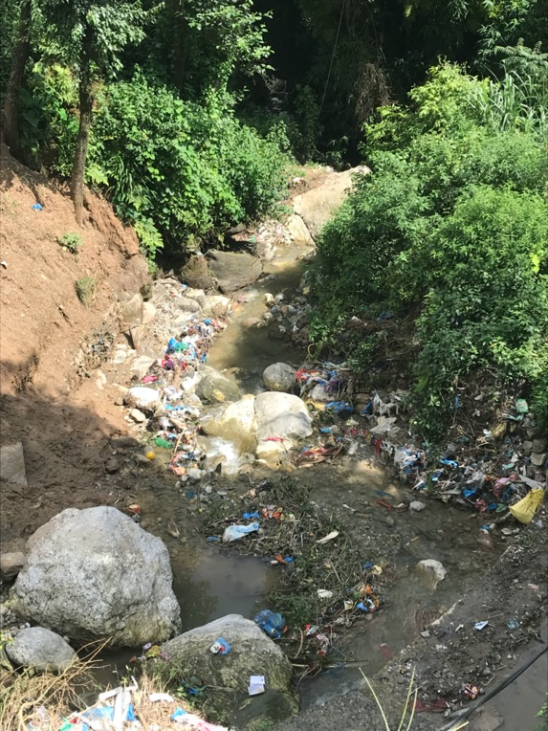
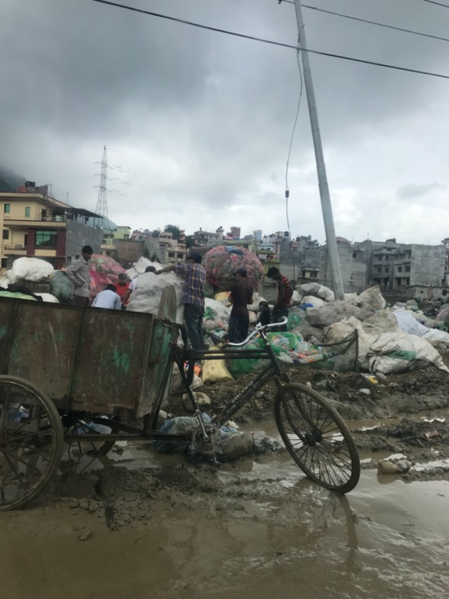
We see garbages on the street & rivers; however, that is not where all the garbge ends up.
Of all the collected garbage, where does it end up?

Slide 20
Life cycle of Garbage in Nepal Kathmandu case
End of life cycle: open dumping
Most of the garbage collected, if not recycled, they end up in open dumping site
Sisdol dumping site

Slide 21
Life Cycle of Garbage in Nepal Kathmandu case
Disposal: Open Dumping – Sisdol Dumping Site
Inhabitants: 1,000,000
Daily waste quantity to Sisdol: between 500 – 1000 t/day
Yearly waste generated per person: 62 kg/person/year
Territory: 13 ha
Operation time: 15 years
Estimated waste quantity: ~ 2,4 mT

Slide 22
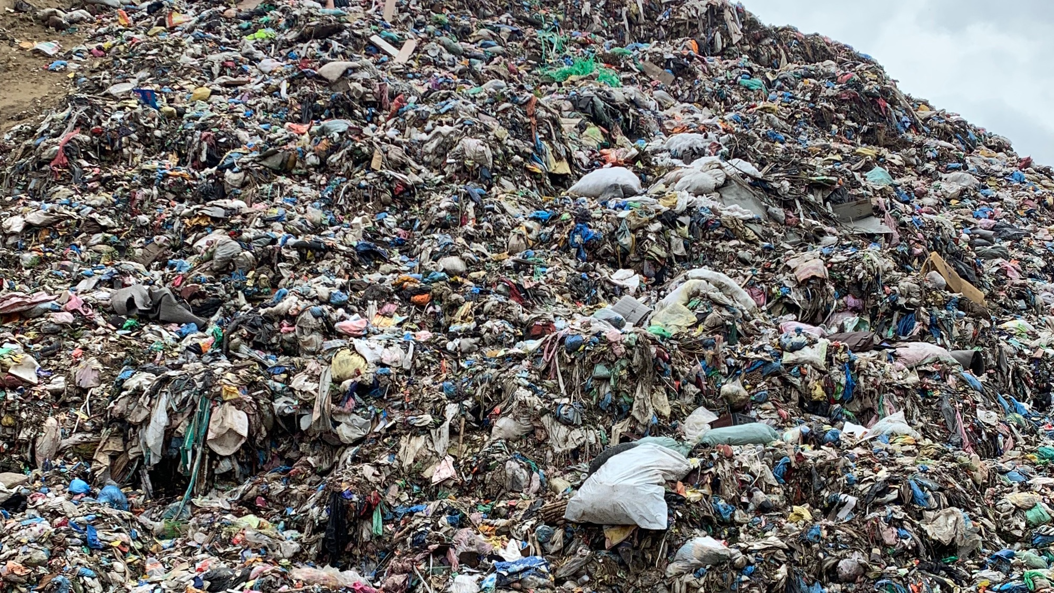
Result & Consequence

Slide 23
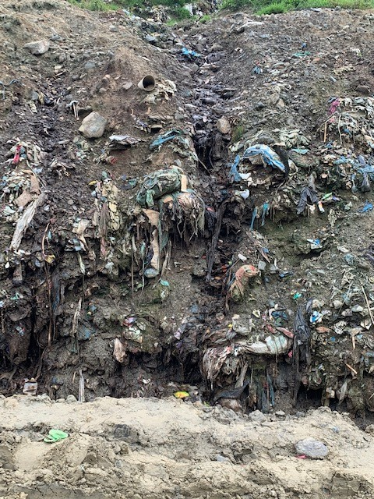
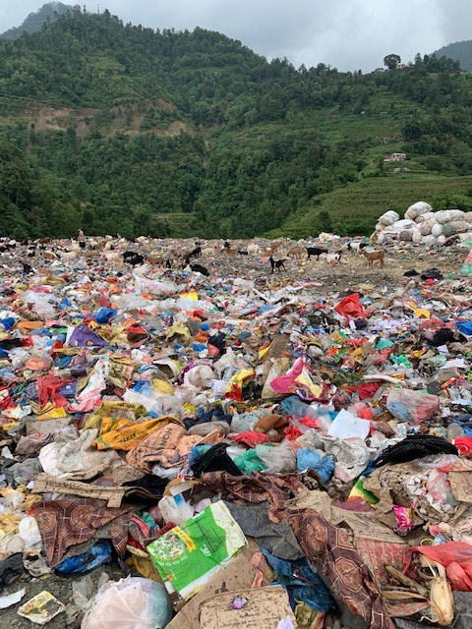
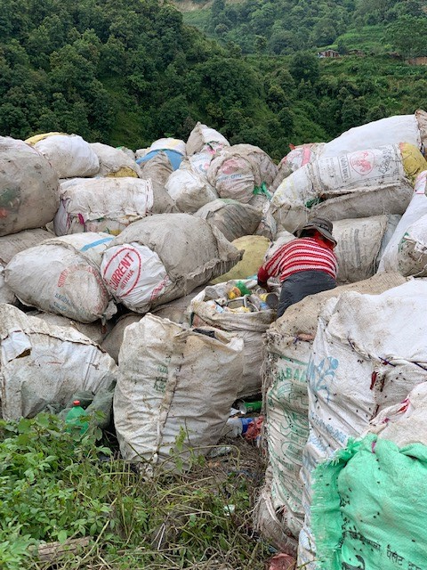
Sisdol Dumping site – Nepal
https://www.youtube.com/watch?v=QBF9THd_hBw

Slide 24
Hazards of open dumping site
Status | Impact
No underground sealing | Polluting the soil & ground water, also spreading heavy metals to other locations
No daily covering | Odour is emitted & pests are spread, also attracting wild animals
No compression | Dumping site occupies larger area due to no compression treatment, it also leads to unstable ground, possible to collapse anytime
No leachate collection | Polliuting the soil, gorund water & rivers by leachate
No biogas encapsulation | Harmful gases are emitted to outer sphere
Open to the environment | Animals & insects come to consume polluted substances, leading to bioaccumulation of pollutants

Slide 25
Life Cycle of Garbage in Nepal
3. Health effect: leachate from open dumping
Leachate is produced when precipitation falls on the waste or when the wastes react with groundwater
Excessive amount of nutrients
High organic and inorganic pollutant contents
Measures to examine the level of pollution for open dumping
pH
BOD (Biological Oxygen Demand)
COD (Chemical Oxygen Demand)
Chlorides
Sulphates
TDS
Cadmium
Lead
Zinc

Slide 26
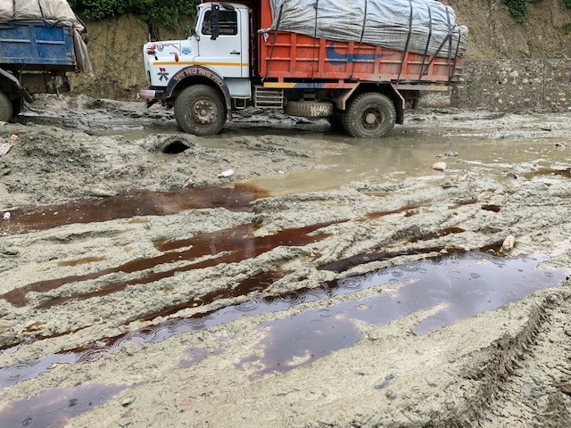
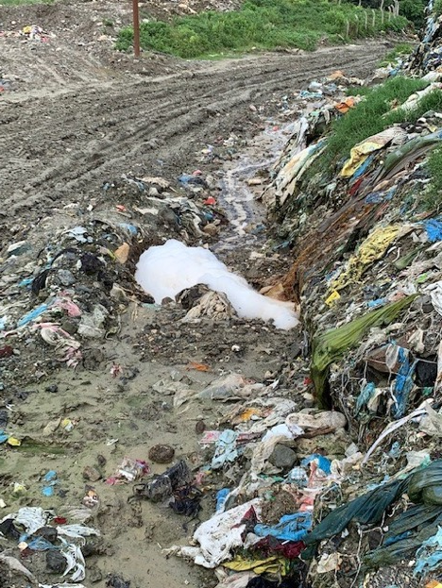
Sisdole – dumping site, Nepal
Leachate in Nepal

Slide 27
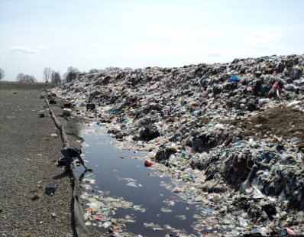
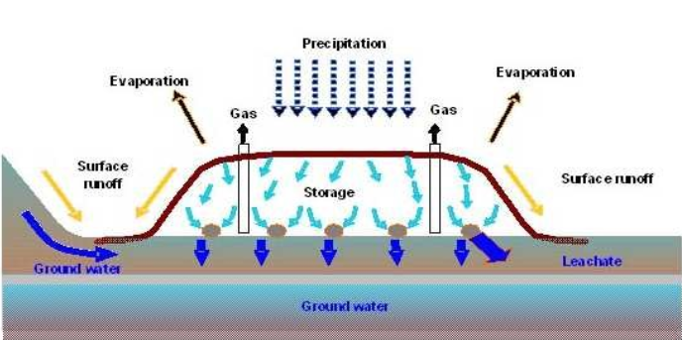
Landfill leachate Leachate is the liquid produced from a landfill as a result of infiltration, compaction and degradation. This contains a numbers of organic, inorganic and toxic chemicals and should be collected and treated properly before discharged into nature. According to the EU-Guidelines "…leachate needs to be collected and treated that it reaches the required quality for discharge…". Defined parameters may not exceed given limits prior to discharge into the environment. These parameters are e.g. COD, BOD, NH₄-N, NO₂, NO₃, AOX and heavy metals.

Slide 28
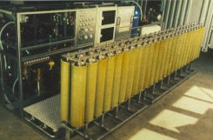
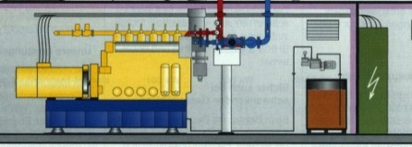
Systematic Overview of Proper Waste Management
§
Legislation
§
§
Leachate data:
today/future
Concentrate disposal
e.g. infiltration
Rainfall
Biogas treatment
Sealing
Direct
discharge
Discharge
into MWTP
Landfill
Underground sealing
River
Ground water

Slide 29
Life Cycle of Garbage in Nepal
3. Health effect: gases emitted from open dumping
Open dumping site produces various gases including large amout of Green House Gases (40-60%)
Gases | Effect on the environment | Effect on the human health
Methane (CH4) | It has green house gas effect 21 times more than CO2 (“high warming potential”) | Evacuation will be necessary due to
Carbon dioxide (CO2) | Major cause of global warming, driver of climate change | Increased ocurrance of extreme weather event, leading to water and food scarcity.
Carbon monooxide (CO) | Carbon monoxide reacts with other pollutants in the air to form potentially harmful ground level ozone. Ground level ozone is related to increased human and vegetation health adversity. This occurs close to the site of emission. | Inhaling the high concentration leads to reduced Oxygen transport by hemoglobin, it causes malfunction of vital organs: including central nervous systems and the heart. Leading to numerous developmental diseases.

Slide 30
Life Cycle of Garbage in Nepal
3. Health effect: gases emitted from open dumping
Gas | Effects on the Environment | Effects on the human health
Nitrogen, Nitrogen Oxide (N, NOx) | Nitrogen oxide contributes to form acid rain | It does not have direct effect on human body; however, ecosystem that supports us will be damaged
Hydrogen sulfide (H2S) | It has rotten-egg like smell at lower concentration and act as high acute (short-term) toxicity to aquatic life, birds, and animals. | Collapse, coma and death from respiratory failure may come within a few seconds after one or two inspirations, at high levels (concentrations of 1000 to 2000 parts per million).
Ammonia (NH3) | “Exposure to high levels of ammonia can cause irritation and serious burns on the skin, and in the mouth, throat (laryngitis), lungs (pulmonary oedema) and eyes (conjunctivitis). Exposure at very high levels of ammonia can lead to death.” | Long term effects may include shortened lifespan, reproductive problems, lowered fertility, and changes in appearance or behaviour. These may be seen long after the first exposure to ammonia.

Slide 31
The Necessity of Sanitary Landfill and leachate treatment
‘‘a method of disposing of refuse on land without creating nuisances or hazards to public health or safety, by utilizing the principles of engineering to confine the refuse to the smallest practical area, to reduce it to the smallest practical volume, and to cover it with a layer of earth at the conclusion of each day’s operation or at such more frequent intervals as may be necessary (Raghab et al., 2013)’’
Many methods of leachate treatment
Aerobic Biological Treatment: such as aerated lagoons and activated sludge.
Anaerobic Biological Treatment: such as anaerobic lagoons, reactors.
Physiochemical treatment: such as air stripping, pH adjustment, chemical precipitation, oxidation, and reduction.
Coagulation using lime, alum, ferric chloride, and land treatment.
Advanced techniques such as carbon adsorption, ion exchange.

Slide 32
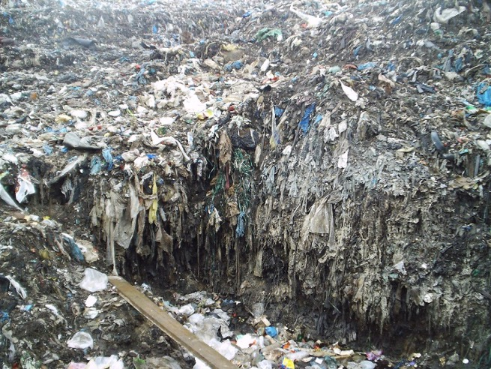
Leachate treatment challenges
Conventional urban wastewater treatment plants don’t remove sufficiently COD, ammonia, nitrogen, salts and heavy metals.
COD is only partly biodegradable
Hard COD is a problem
Only reverse osmosis treatment can provide stable and reliable effluent values which meet the local discharge values at any time.

Slide 33
Possible Solutions
・Black Soldier Fly composting
Reducing the amount of waste goes to landfill
・Integrated Landfill
Creating place that can safely eliminate wastes
・Biomethane production /(Incinerating waste to create electricity)
Using wastes to produce energy
What we should look for is “small early success”
Black Soldier Fly is the easiest to implement

Slide 34
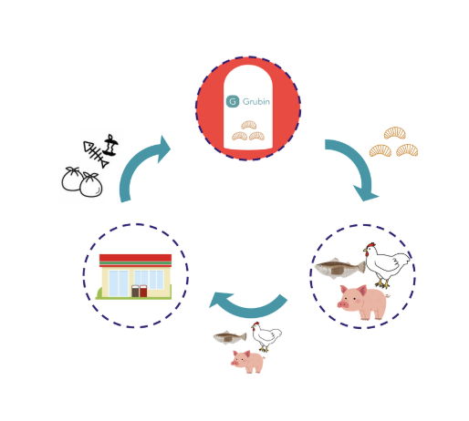
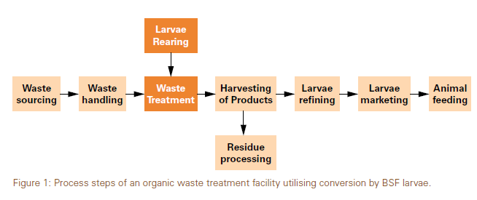
Black Soldier Fly (BSF) composting
Black Soldier Fly larvae decompose organic waste at an incredible rate
The mature larvae will be made into fish and chicken feed
Fish and chickens raised with BSF feed would be back to our tables
https://www.grubin.jp/
We can reduce the amount of waste that goes to landfill
・60-70% of all wastes are organic, thus we can decrease substantially

Slide 35
Why Black Soldier Fly (BSF)?
6 reasons for BSF composting
They are the most productive converter of organic waste into protein
BSF larvae eats twice as much as their body weight everyday for 18 days.
When they become pupa, 43% is protein, also with high calcium content. (Excellent feed for chickens).
To obtain 1kg of each protein source, BSF is the most efficient converter.
Beef: 10 kg feed
Mealworm: 2kg feed
BSF: 1.5kg feed
They are clean source of food and do not spread disease
“their digestive processes kill any bacteria that they may encounter in their own food.”
Black soldier fly does not eat any food but survive with reserve, they do not have mouse, thus they do not become source of pathogens; they are no threat to human health.
“They do not regurgitate food along with digestive enzymes like houseflies, thus do not spread diseases.”
They reproduce at high rate
Life-cycle of BSF is short, so we can rotate to use for composting in rapid pace (6 weeks cycle). Continually for all year around in the facility.
One female BSF give birth to 500 eggs, thus being able to scale up the operation quickly.

Slide 36
Why Black Soldier Fly (BSF)?
reasons for BSF composting
4. They are easy to grow and harvest
They are super easy to take care of as they are super survivor.
“the small larvae hate light. So, when you want to harvest them, all you need to do is give them a bucket as a shelter, and they will harvest themselves”.
5. BSF left overs become excellent fertilizer
Growing BSF will produce food and feed from organic waste but also, the left overs (their poop, dead flies, egg leftovers) produces a high quality fertilizer for plants.
The residue is called “frass”
6. They are everywhere
They are originally from South Eastern US, but now they inhabit all continents in the world.
They are not invasive speices.
7. They kill other unwanted bags
“Their large size relative to houseflies and blowflies allows them to prevent houseflies and blowflies from laying eggs in decaying matter by consuming larvae of other species.”
Notes:
(immersed in alcohol for 2hrs and they still live etc.)

Slide 37
Why Black Soldier Fly (BSF)?
9 reasons for BSF composting
8. They are only attracted to rotten food
As detritivores and coprovore, egg bearing females are attracted to the smell of rotten food or manure. Making them away from human living space.
9. They are potentially be used for safely decomposing excrement of humans and animals
They can decompose excrements of animals; however, feeding directly the larvae to animals is not recommended
Excrements to fertilizer is viable option.
~Waste is Valuable~
Black Soldier Fly enables circular economy; wastes that are currently discarded and being the source of hazards can become valuable animal feeds

Slide 38
Demonstrated and success in Cambodia
This document is provided by Grubin (next 5 slides)
https://www.dropbox.com/s/go8ekm352g4e98c/Grubin%20in%20short.pdf?dl=0

Slide 39
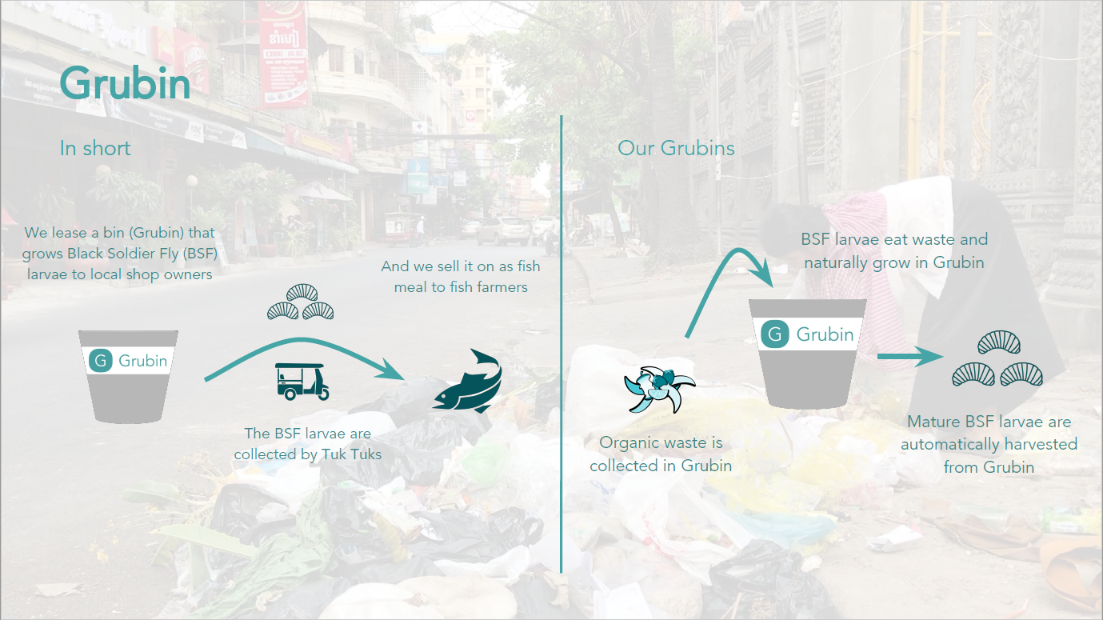

Slide 42
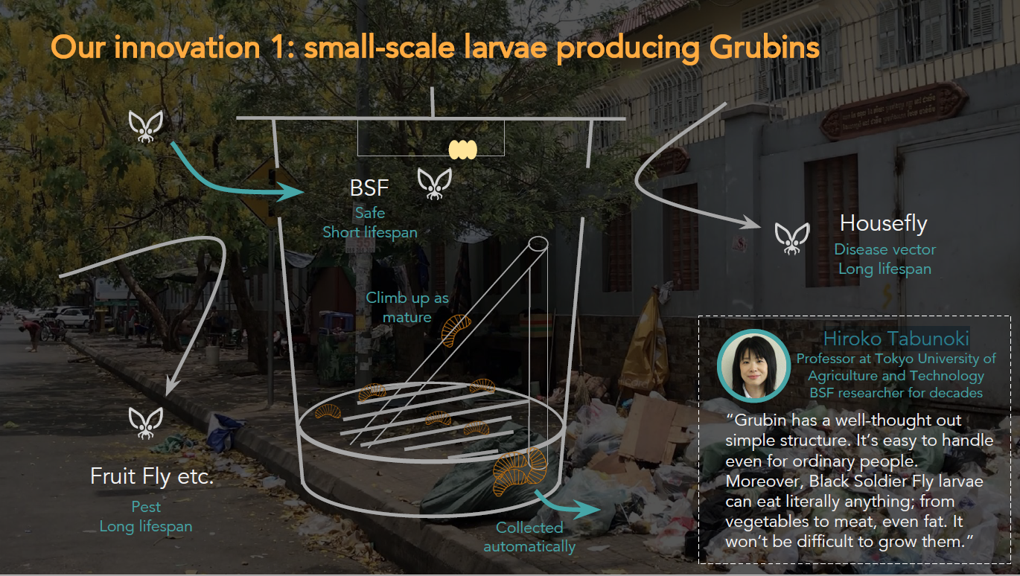

Slide 44
References
Pokhrel, D., & Viraraghavan, T. (2005). Municipal solid waste management in nepal: Practices and challenges. Waste Management, 25(5), 555-562. doi:10.1016/j.wasman.2005.01.020
Methane effect (http://apps.sepa.org.uk/SPRIPA/Pages/SubstanceInformation.aspx?pid=65)
Hydrogen sulphide effect (http://www.npi.gov.au/resource/hydrogen-sulfidez)
Ammonia effect (http://www.npi.gov.au/resource/ammonia-total)
Muhammad, Hafsa, Abdul, D., & Waqas. (2017). a case study of groundwater contamination due to open dumping of municipal solid waste in faisalabad, pakistan. Earth Sciences Pakistan, 1(2), 15-16. doi:10.26480/esp.02.2017.15.16
Kanmani, S., Kanmani, S., Gandhimathi, R., & Gandhimathi, R. (2013;2012;). Assessment of heavy metal contamination in soil due to leachate migration from an open dumping site.Applied Water Science, 3(1), 193-205. doi:10.1007/s13201-012-0072-z
13 reasons why BSF is great (https://www.eatcrickster.com/blog/black-soldier-fly?fbclid=IwAR0rJjmvqjPV_MUSUGJ9qYuLOyrSjk4_bI0YfOCFG6XcQDftT495Q6mxAgw)

